Slide 1
Artificial Intelligence
CS Bridge 2021

Slide 2
Some logistics…
Notes:
hoy tenemos una mañana muy emocionante

Slide 3
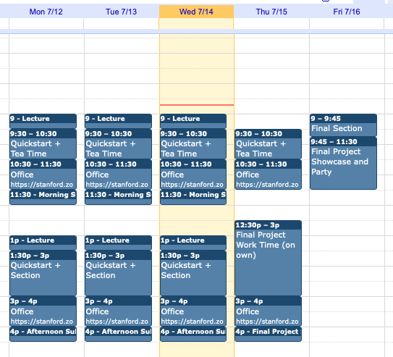

Slide 4
Post on Ed about how to submit the final project

Slide 5
Artificial Intelligence
Notes:
hoy tenemos una mañana muy emocionante

Slide 6
A Little AI
Notes:
Just want to show you a cool demo
Not intelligent yet will train while we talk
Fun fact: karpathy wrote this

Slide 7
Something big is happening
in the world of AI…

Slide 8
Where is my robot?
Notes:
I want to start with a q:
Why don’t we have one yet

Slide 9
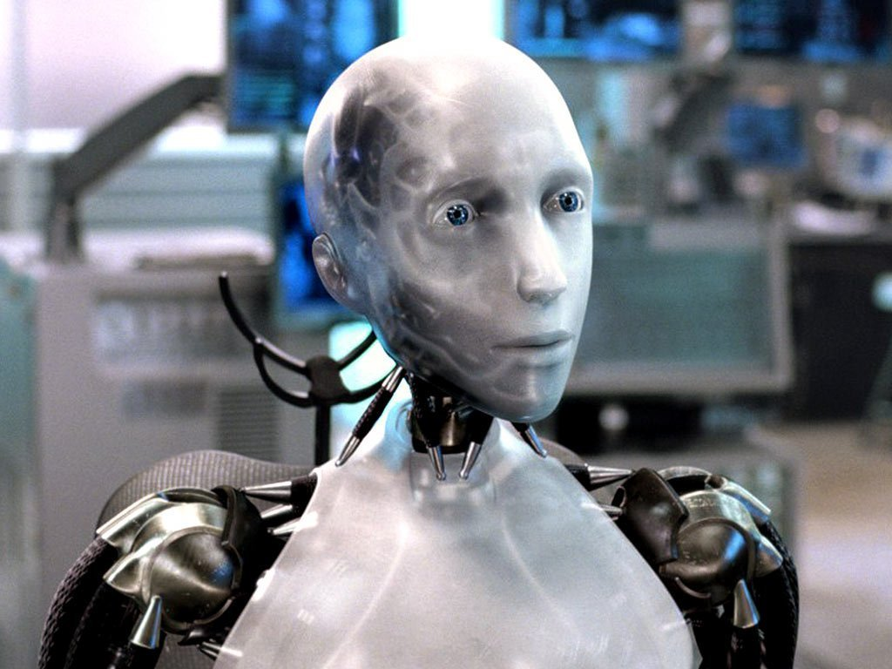
Sci-Fi Has Promised Me Robots

Slide 10
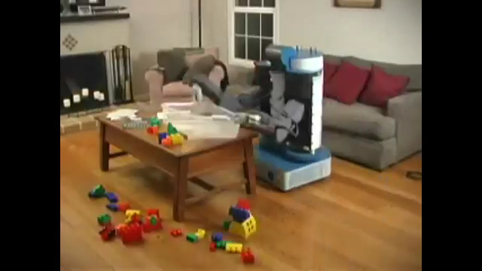
House Cleaning Robot
Notes:
Here’s an old video of a robot cleaning a house

Slide 11
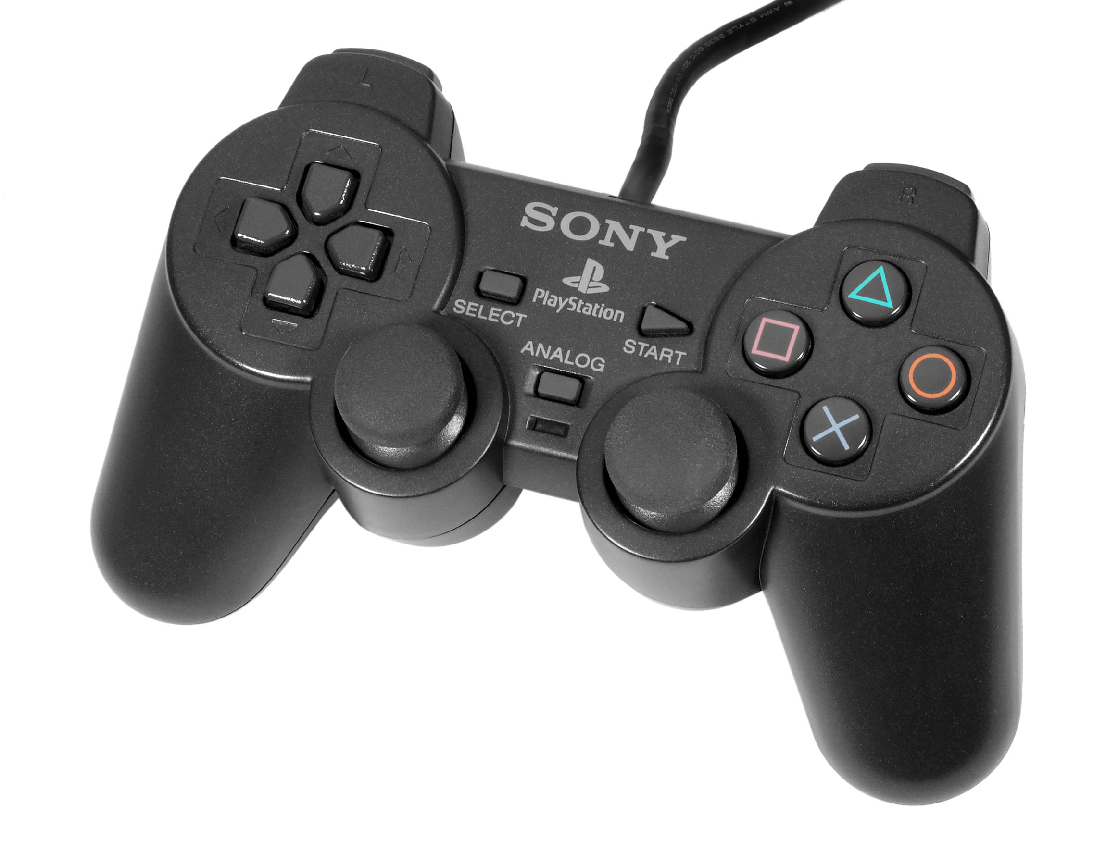
House Cleaning Robot
Notes:
Cheat: there was a graduate student controlling the robot

Slide 12
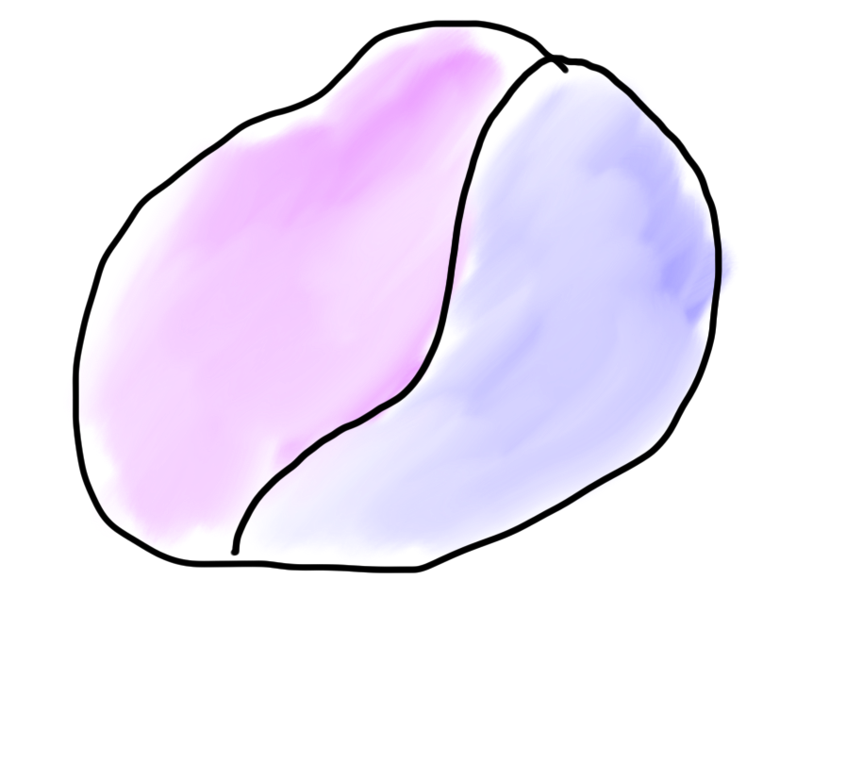
Robots?
Mind
Body
Notes:
While speaks to nature of AI
Difficult part is the mind and that’s what AI is about.

Slide 13

Robots?
Mind
Body

Slide 14
What is AI?
Notes:
Worths tarting with, what is AI.

Slide 15
[suspense]

Slide 16
AI: The study and design of intelligent agents
Notes:
AI means a lot of things

Slide 17
Computer
programs
AI: The study and design of intelligent agents
Better than
chance
As well as
humans

Slide 18
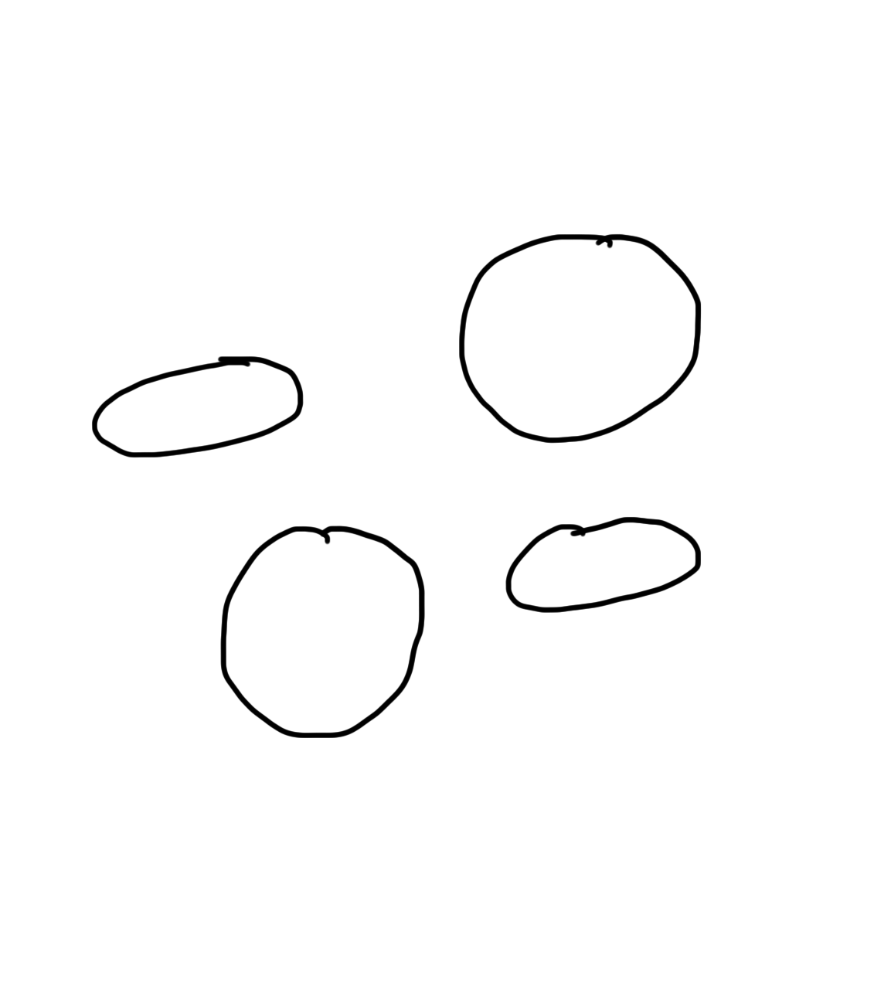
Narrow Intelligence
Translate
Turkish or Czech
Play Chess
Play Breakout
Drive a
Car
Notes:
Theres a few diff versions of AI.

Slide 19
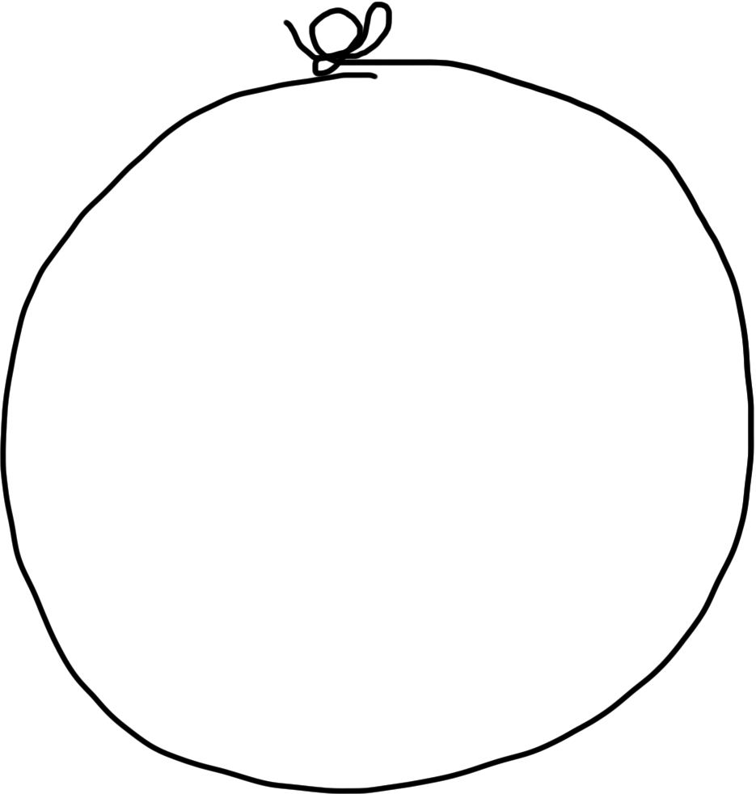
General Intelligence
Translate
Turkish
Play Chess
Play Breakout
Drive a
Car
Notes:
Don’t have a general intelligence

Slide 20
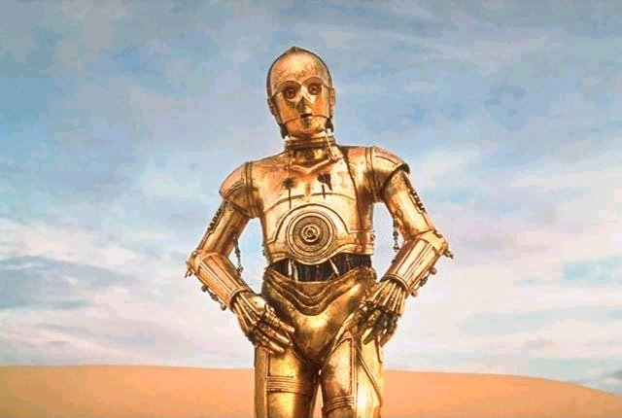
Brief History
Notes:
Reflext on history

Slide 21
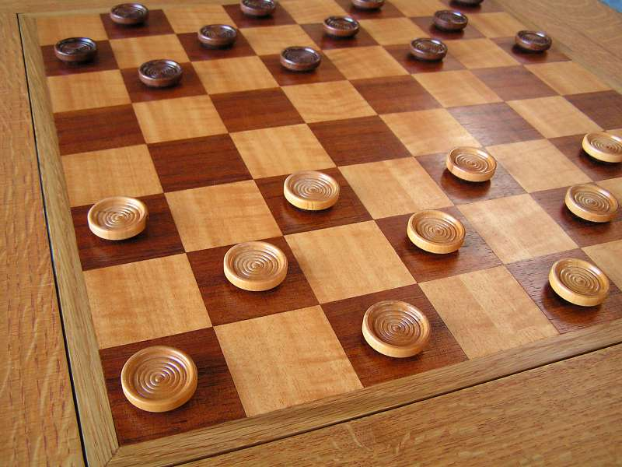
Early Optimism 1950s
1952
Notes:
Invented witht the first computers. Akan turing wrote AI to break enigma

Slide 22
Early Optimism 1950s
“Machines will be capable, within twenty years, of doing any work a man can do.”
–Herbert Simon, 1952
Notes:
Ridiculous for two reasons

Slide 23
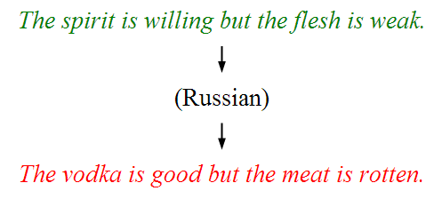
Underwhelming Results 1950s to 1980s
The world is too complex
Notes:
he got funding to do a huge amount of research

Slide 24

Notes:
Didn’t live up to the hype

Slide 25

Big Milestones

Slide 26
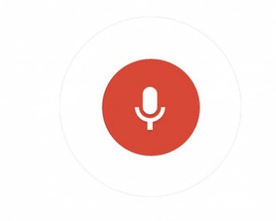
Told Speech Was 30 Years Out
Almost perfect…
Notes:
This used to be an unsolvable problem.

Slide 27
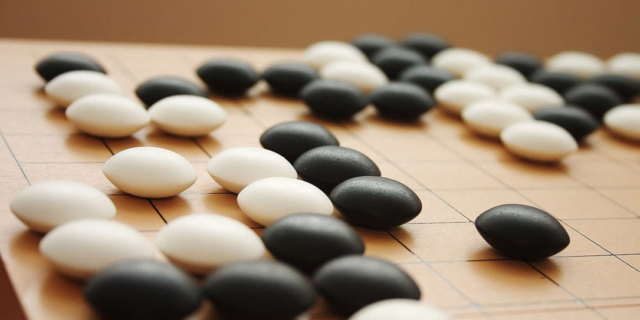
The Last Remaining Board Game

Slide 28
Computers Making Art
Notes:
Rembrandt painting

Slide 29
Self Driving Cars

Slide 30
What is going on?

Slide 31
[more suspense]

Slide 32
Story of Modern AI

Slide 33
Focus on one problem

Slide 34
Make a Harry Potter Sorting Hat

Slide 35

Classification
Logistic Regression is like the Harry Pottery Sorting Hat
That is a picture
of a one

Slide 36

Classification
Logistic Regression is like the Harry Pottery Sorting Hat
That is a picture
of a zero

Slide 37

Classification
That is a picture
of an zero
* It doesn’t have to be correct all of the time

Slide 38
Can you do it?

Slide 39


Slide 40


Slide 41

How about now?
What a computer sees
0 | 0 | 1 | 0 | 1 | 0 | 1 | 0 | 0 | 0 | 1 | 1 | 1 | 0 | 1
1 | 0 | 0 | 1 | 0 | 1 | 1 | 1 | 0 | 1 | 0 | 0 | 0 | 0 | 0
1 | 1 | 1 | 0 | 1 | 0 | 0 | 1 | 1 | 0 | 0 | 1 | 0 | 1 | 0
1 | 1 | 1 | 1 | 1 | 0 | 0 | 0 | 0 | 0 | 1 | 1 | 0 | 1 | 1
0 | 0 | 0 | 1 | 1 | 0 | 0 | 1 | 0 | 0 | 0 | 1 | 1 | 1 | 0
1 | 0 | 0 | 1 | 1 | 0 | 0 | 0 | 1 | 0 | 1 | 1 | 1 | 1 | 0
1 | 1 | 0 | 1 | 1 | 0 | 0 | 1 | 1 | 0 | 1 | 1 | 1 | 0 | 0
1 | 0 | 1 | 0 | 0 | 1 | 0 | 0 | 1 | 0 | 0 | 1 | 1 | 1 | 1
0 | 0 | 0 | 0 | 1 | 0 | 1 | 0 | 1 | 1 | 0 | 0 | 1 | 1 | 1
0 | 1 | 1 | 0 | 0 | 0 | 0 | 0 | 1 | 1 | 1 | 1 | 1 | 1 | 0
0 | 0 | 1 | 0 | 1 | 1 | 1 | 0 | 0 | 0 | 1 | 0 | 0 | 0 | 0
0 | 1 | 1 | 1 | 0 | 1 | 0 | 0 | 1 | 0 | 0 | 0 | 0 | 0 | 1
1 | 1 | 0 | 0 | 0 | 0 | 0 | 0 | 0 | 0 | 1 | 0 | 0 | 1 | 1
0 | 0 | 0 | 0 | 0 | 0 | 0 | 0 | 1 | 1 | 1 | 1 | 0 | 0 | 1
0 | 0 | 1 | 1 | 1 | 0 | 1 | 0 | 1 | 1 | 0 | 0 | 0 | 1 | 0
What a human sees

Slide 42
Why is it easy for Humans?
About 30% of your cortex is used for vision
3% is used to process hearing

Slide 43
Very hard to Program
??
def main():
print(“Todo: Write program”)
Notes:
Now what if you had to program this? Very hard to describe in code

Slide 44
Perhaps there is an insight?

Slide 45
Two Great Ideas
1. Artificial Neurons
2. Learn by Example
Notes:
Going to teach two great ideas behind modern AI

Slide 46
Two Great Ideas
1. Artificial Neurons
2. Learn by Example

Slide 47
1. Artificial Neurons
Notes:
want to give you a brief idea of neurons

Slide 48
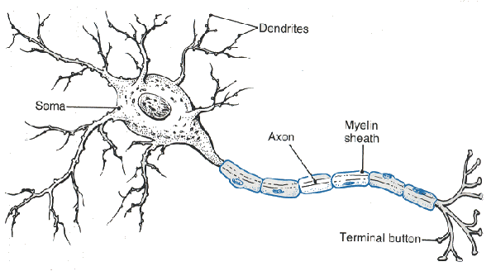
Neuron

Slide 49
Neuron

Slide 50
Neuron

Slide 51
Neuron

Slide 52
Neuron

Slide 53
Some Inputs are More Important
Notes:
Some inputs get more importance than others.

Slide 54
Artificial Neuron

Slide 55




Inputs
+

Slide 56
Inputs
+

Slide 57
Inputs
+

Slide 58
Weights
+

Slide 59
Weights
+

Slide 60
Weights
+

Slide 61
Weighted Sum
+
weightedSum = 0
weightedSum = weightedSum + input0 * weight0
weightedSum = weightedSum + input1 * weight1
weightedSum = weightedSum + input2 * weight2
weightedSum = weightedSum + input3 * weight3

Slide 62
Weighted Sum
+
weightedSum = 0
for i in range(4):
weightedSum += weight[i] * input[i]

Slide 63
Filter and Output
+

Slide 64
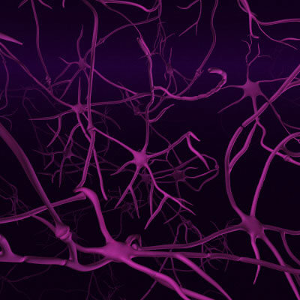
Biological Basis for Neural Networks
A neuron
Your brain
Actually, it’s probably someone else’s brain
???

Slide 65
Put Many Together
+
+
+
+

Slide 66
Put Many Together
+
+
+
+

Slide 67
Put Many Together
Input Neurons
Hidden Neurons
Output Neurons

Slide 68
Making a Prediction
Input Neurons
Hidden Neurons
Output Neurons
…

Slide 69
Making a Prediction
Input Neurons
Hidden Neurons
Output Neurons
…

Slide 70
Making a Prediction
Input Neurons
Hidden Neurons
Output Neurons
…

Slide 71
Making a Prediction
Input Neurons
Hidden Neurons
Output Neurons
I think that is a picture of a one!
…

Slide 72
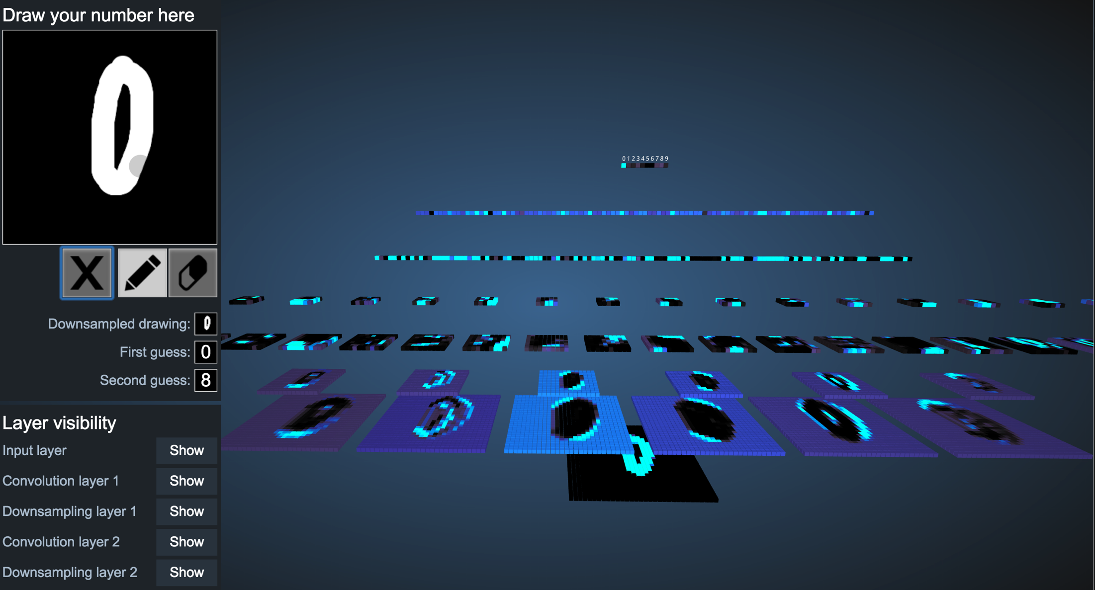
Demonstration
http://scs.ryerson.ca/~aharley/vis/conv/

Slide 73
Great Idea: Artificial Neurons

Slide 74
Neural Networks get their intelligence from their sliders (parameters)

Slide 75
Two Great Ideas
1. Artificial Neurons
2. Learn by Example

Slide 76
Two Great Ideas
1. Artificial Neurons
2. Learn by Example

Slide 77
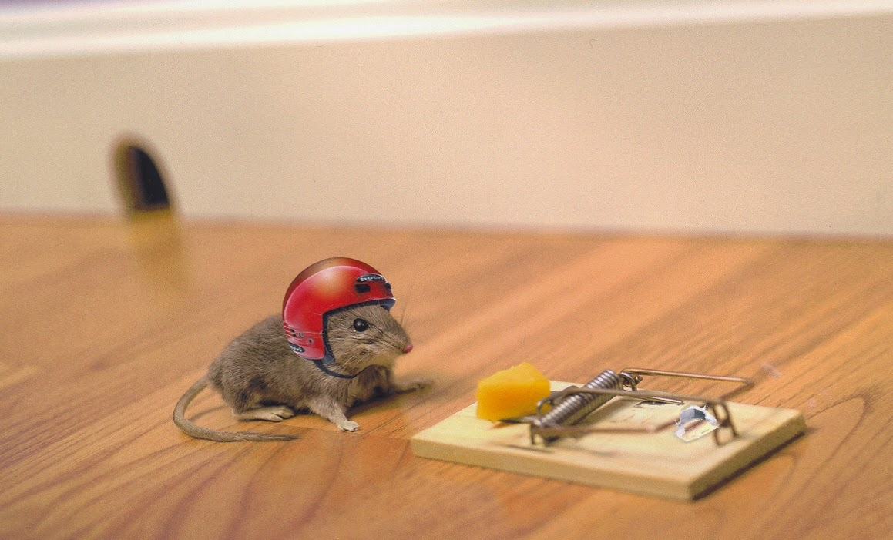
2. Learn From Experience

Slide 78

Learn by Example

Slide 79
+

Slide 80
+

Slide 81
I think that is a picture of a One!
+
What do you mean it’s actually a Zero?
I’ll adjust my sliders so that I do a better job in the future

Slide 82
I think that is a picture of a One!
+
What do you mean it’s actually a Zero?
I’ll adjust my sliders so that I do a better job in the future

Slide 83
+

Slide 84
+

Slide 85
+

Slide 86
I think that is a picture of a One!
+
Wahoo I got it right!

Slide 87
+

Slide 88
+

Slide 89
I think that is a picture of a zero!
+
What do you mean it’s actually a one?
I’ll adjust my sliders so that I do a better job in the future

Slide 90
I think that is a picture of a zero!
+
What do you mean it’s actually a one?
I’ll adjust my sliders so that I do a better job in the future

Slide 91
Study Hard!

Slide 92
Train on Faces

Slide 93
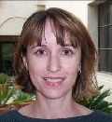
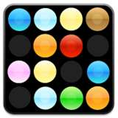
Visualize the Sliders
object models
object parts
(combination
of edges)
Training set: Aligned
images of faces.
edges
pixels
[Honglak Lee]

Slide 94
Woah… that’s like a brain…

Slide 95
True.

Slide 96
Decomposition
Mountain Karel
Climb Up Mountain
Step Up
Pick Beeper
Climb Down Mountain
Step Down
Notes:
He looks like an old machintosh machine.
Hes got legs… one sticks out the back. That’s just the way it is.

Slide 97
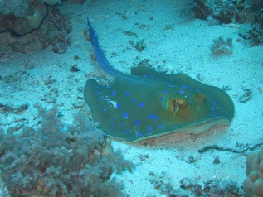
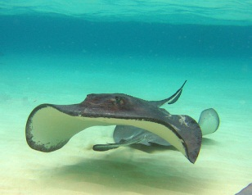
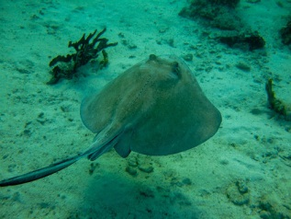
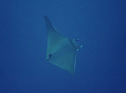
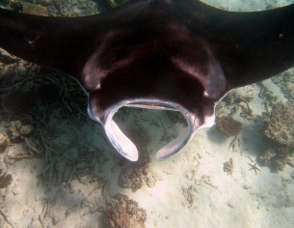
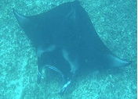
Image Net Classification
…
smoothhound, smoothhound shark, Mustelus mustelus
American smooth dogfish, Mustelus canis
Florida smoothhound, Mustelus norrisi
whitetip shark, reef whitetip shark, Triaenodon obseus
Atlantic spiny dogfish, Squalus acanthias
Pacific spiny dogfish, Squalus suckleyi
hammerhead, hammerhead shark
smooth hammerhead, Sphyrna zygaena
smalleye hammerhead, Sphyrna tudes
shovelhead, bonnethead, bonnet shark, Sphyrna tiburo
angel shark, angelfish, Squatina squatina, monkfish
electric ray, crampfish, numbfish, torpedo
smalltooth sawfish, Pristis pectinatus
guitarfish
roughtail stingray, Dasyatis centroura
butterfly ray
eagle ray
spotted eagle ray, spotted ray, Aetobatus narinari
cownose ray, cow-nosed ray, Rhinoptera bonasus
manta, manta ray, devilfish
Atlantic manta, Manta birostris
devil ray, Mobula hypostoma
grey skate, gray skate, Raja batis
little skate, Raja erinacea
…
Stingray
Mantaray

Slide 98
0.005%
1.5%
?
Random guess
Pre Neural Networks
GoogLeNet
Le, et al., Building high-level features using large-scale unsupervised learning. ICML 2012

Slide 99
0.005%
1.5%
43.9%
Random guess
Pre Neural Networks
GoogLeNet
Szegedy et al, Going Deeper With Convolutions, CVPR 2015

Slide 100
0.005%
1.5%
66.3%
Random guess
Pre Neural Networks
2016
http://image-net.org/challenges/LSVRC/2016/results

Slide 101
0.005%
1.5%
66.3%
Random guess
Pre Neural Networks
2016
http://image-net.org/challenges/LSVRC/2016/results

Slide 102
0.005%
1.5%
90.4%
Random guess
Pre Neural Networks
2021
https://paperswithcode.com/sota/image-classification-on-imagenet

Slide 104

Google Brain

Slide 105
Google Brain
1 Trillion Artificial Neurons

Slide 106
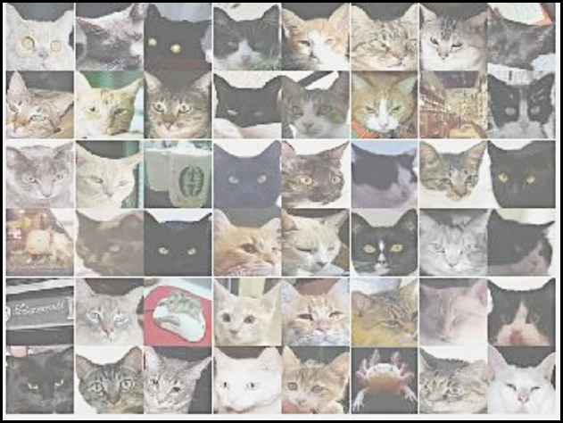
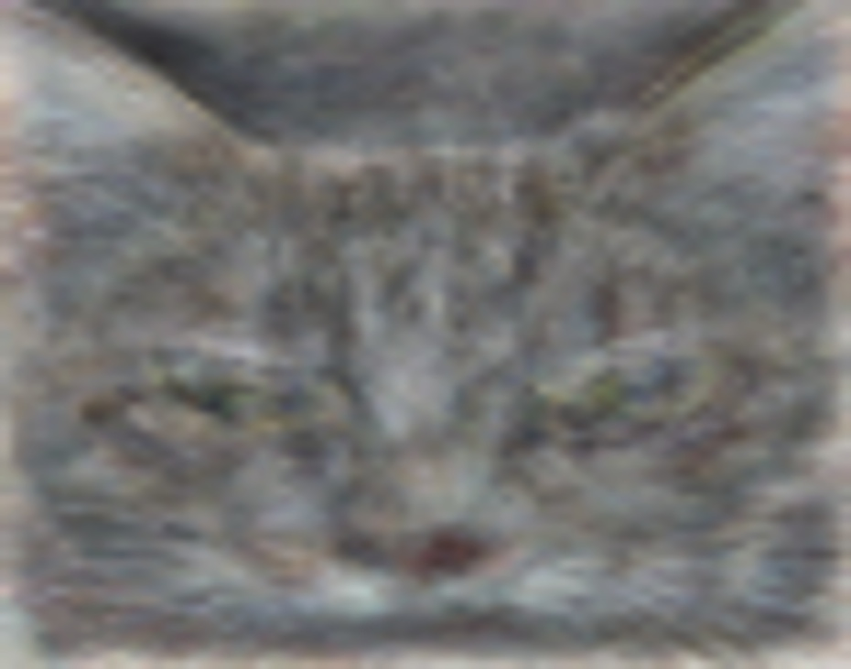
A Neuron That Fires When It Sees Cats
Top stimuli from the test set
Optimal stimulus
by numerical optimization
Le, et al., Building high-level features using large-scale unsupervised learning. ICML 2012

Slide 108



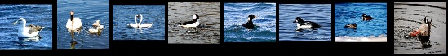

Other Neurons
Neuron 1
Neuron 2
Neuron 3
Neuron 4
Neuron 5
Le, et al., Building high-level features using large-scale unsupervised learning. ICML 2012
Input to another layer above
(image with 8 channels)
Number of output
channels = 8
LCN Size = 5
H
Pooling Size = 5
Number
of maps = 8
One layer
W
RF size = 18
Number of input
channels = 3
Image Size = 200

Slide 109
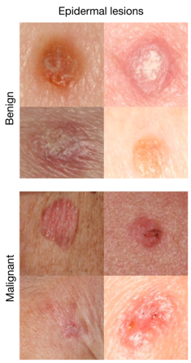
It can be useful
An algorithm learned to detect skin cancer from photo, better than the worlds top expert.
Developed last year
Esteva, Andre, et al. "Dermatologist-level classification of skin cancer with deep neural networks." Nature 542.7639 (2017): 115-118.
Esteva et al., Nature 2017.

Slide 110
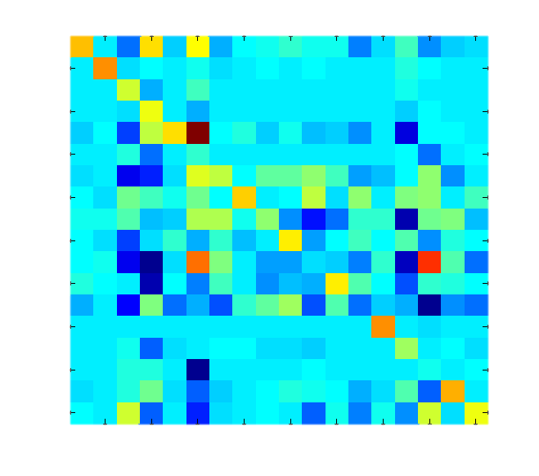
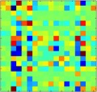
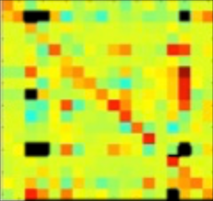
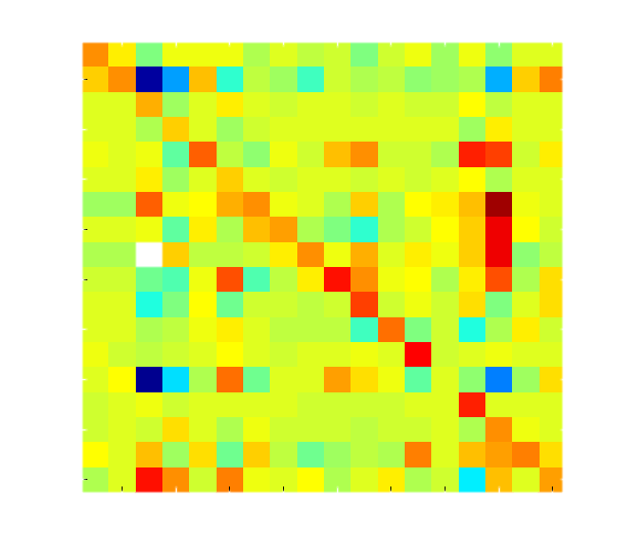
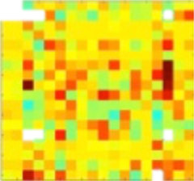
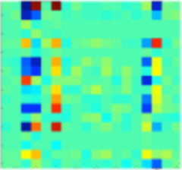

Helping Students Learn to Program
It looks like you have a fencepost error!
// User defined method
def main():
while(isClear()):
put_beeper()
move()
put_beeper()
main
while
putBeeper
cond
body
putBeeper
move

Slide 111
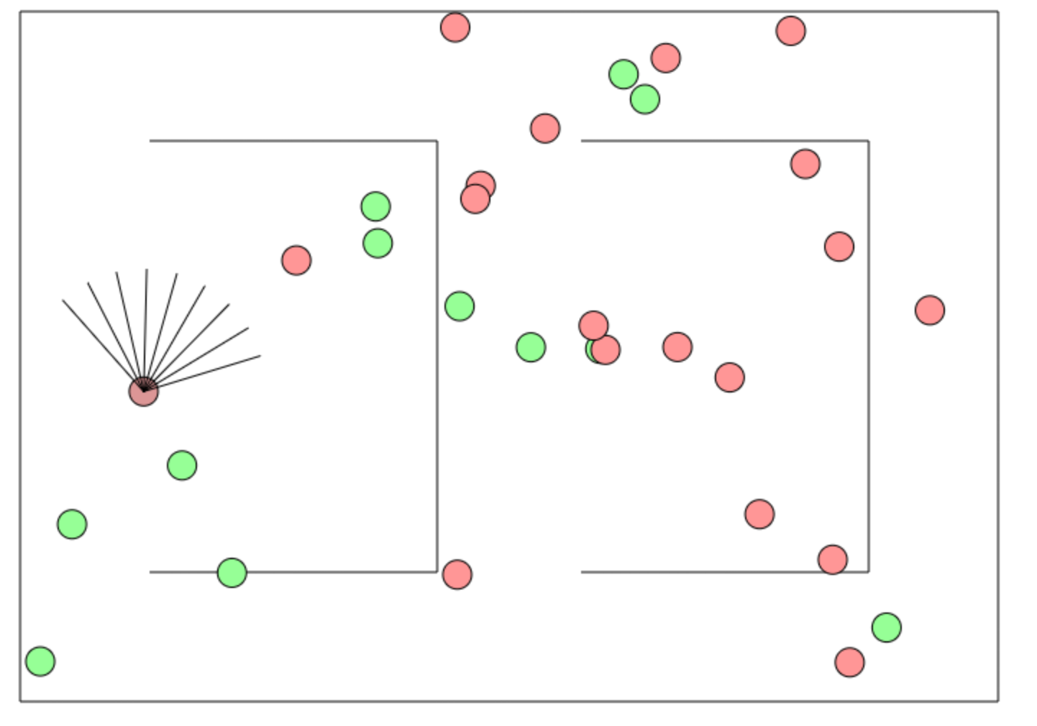
Beyond Harry Potter Hats
http://cs.stanford.edu/people/karpathy/convnetjs/demo/rldemo.html

Slide 112
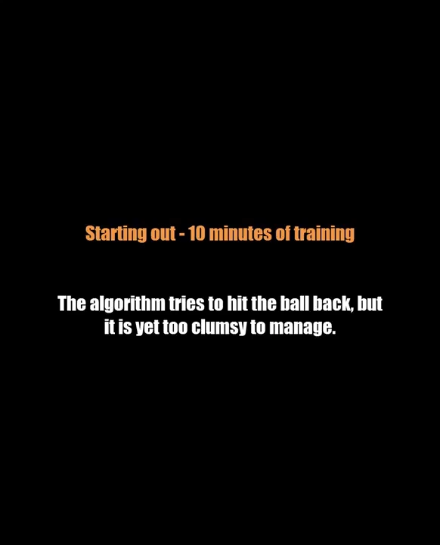
Beyond Classification

Slide 113
The Future of AI
Human Intelligence
Performance
Complex Programs
Neural Networks
Time
Now
2012
Notes:
NVIDIA or ATI will be future of AI. Probably NVIDIA.

Slide 114
The Future of AI
Human Intelligence
Performance
Complex Programs
Neural Networks
Time
Now
2012
Notes:
NVIDIA or ATI will be future of AI. Probably NVIDIA.

Slide 115
The Future of AI
Human Intelligence
Performance
Complex Programs
Neural Networks
Time
Now
2012
Notes:
NVIDIA or ATI will be future of AI. Probably NVIDIA.

Slide 116
The Future of AI
Einstein
Human Intelligence
Performance
Complex Programs
Neural Networks
Time
Now
2012
Notes:
NVIDIA or ATI will be future of AI. Probably NVIDIA.

Slide 117
Open Problems?

Slide 118
Machine Learning Uses a Lot of Data

Slide 119
One Shot Learning
Single training example:
Test set:

Slide 120
One Shot Learning
Single
training
example:

Slide 121
Where is my robot?

Slide 122
… coming soon

Slide 123
Should I study AI?

Slide 124

Powerful technology

Slide 125
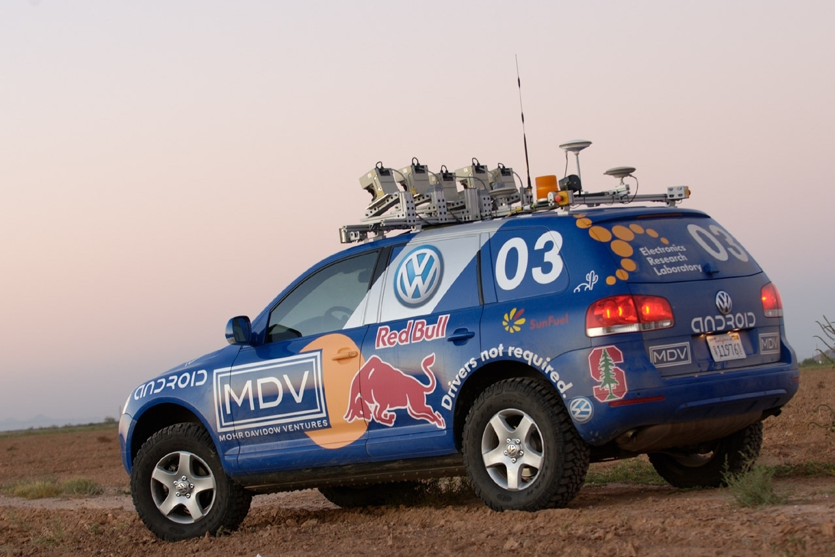
Now is an amazing time

Slide 126
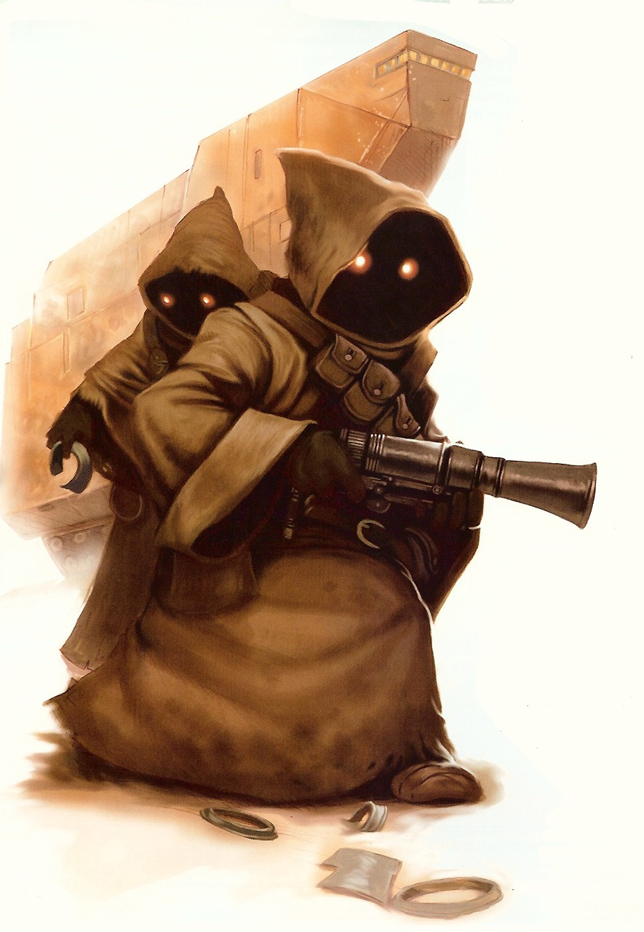
Know It So You Can Beat It
Little math

Slide 127
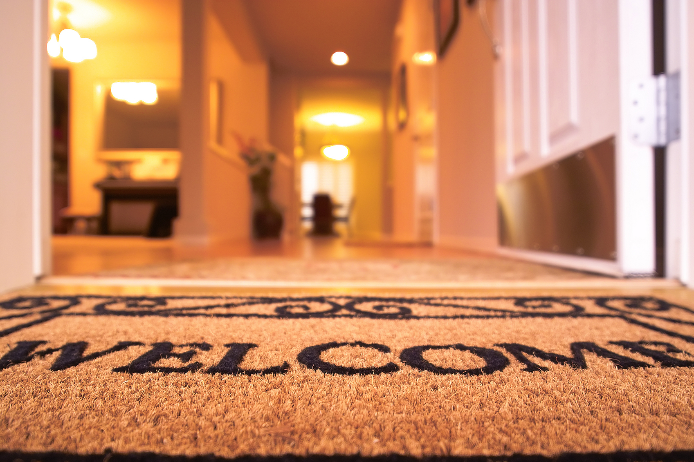
Todos son bienvenidos

Slide 128

Road towards AI
Libraries to use AI
Mathematics to invent AI

Slide 129
Next Step:
…

Slide 131
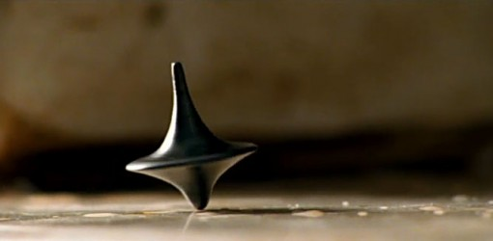
The End?

